Slide 1
Welcome FeatureCAM 2007
Training
Basic 2.5D Features

Slide 2
FeatureCAM
Delcam USA

Slide 3
Agenda
Session 1
Introduction to Features
1. Feature Creation
2. Feature Types
3. Feature Wizard
4. Features From Dimensions
a. Hole feature types
5. Features from Curves
a. Boss, Pocket, Side
6. Patterns
7. Groups
Session 2
Milled Features
1. New Feature Wizard
Drilled Features
1. New Feature Wizard
Milled Attributes
1. Properties
Drilled Attributes
1. Properties
Attributes
1. Machining Attributes
2. Feature Attributes
3. Operations Attributes

Slide 4
Introduction to Features
Features are the intelligent core entities that a machinist would use to make a certain shape in the material they are cutting. Shapes such as a hole, boss, slot, etc…
Features are used to make toolpaths in FeatureCAM
Features may generate several operations that all work together to produce the final result.

Slide 5
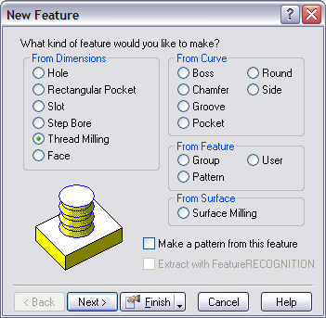


Feature Creation
Features are created by using the Feature Step
The New Feature Wizard steps you through the creation of a feature
Notes:
Four General Types:
“From Dimensions” Look at the new feature wizard and select each radio button. Show how the picture changes for each one. These are standard features.
“From Curve” Look at the new feature wizard and select each radio button. Show how the picture changes for each one. This might be a good time to see if there are any problems with the vocabulary. These are the simple shop terms.
“From Feature”- Look at the difference between a group and a pattern.
“Surface Milling”- simultaneous x,y,z movement. Discussed later.

Slide 6
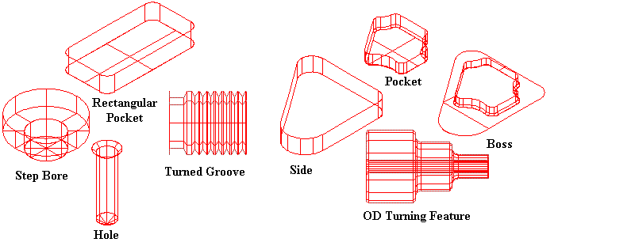
Feature Types
Standard features can be created from dimensions
More customized shapes must be created from curves
From Dimensions
From Curves
Notes:
Sometimes it is very easy to define a feature with dimensions.
Depending on the shape of the feature it may be easier to define it with a drawing, solid or surface.

Slide 7
Feature Wizard
Notes:
Note how the figure will change depending on the feature selected.

Slide 8
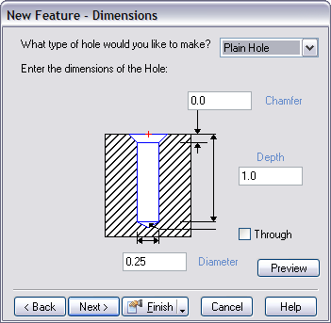
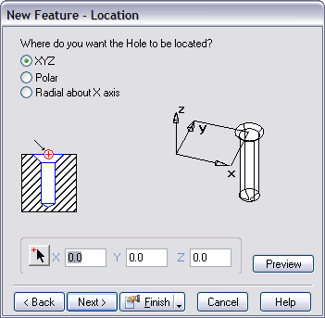
Feature Wizard
Dimensions page is where you specify the numeric dimensions of the feature
If the feature requires a curve, it is entered on the curves page
Use the location page to place the feature
1
2

Slide 9
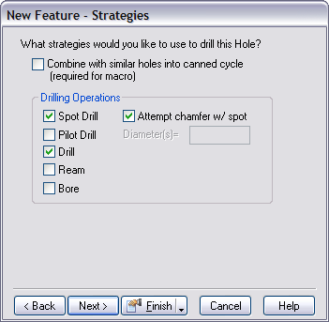
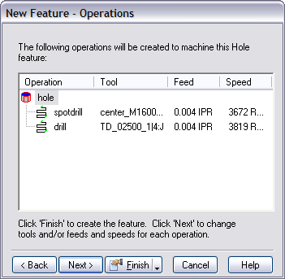
Feature Wizard
Strategy page determines how the feature will be cut
Operations page summarizes
  Operations
  Tooling
  Feed
  Speed
3
4
Notes:
The operations page shows the result of all of FeatureCAM’s automation.

Slide 10
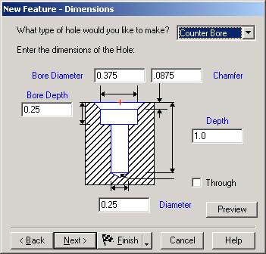
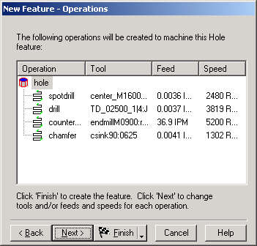
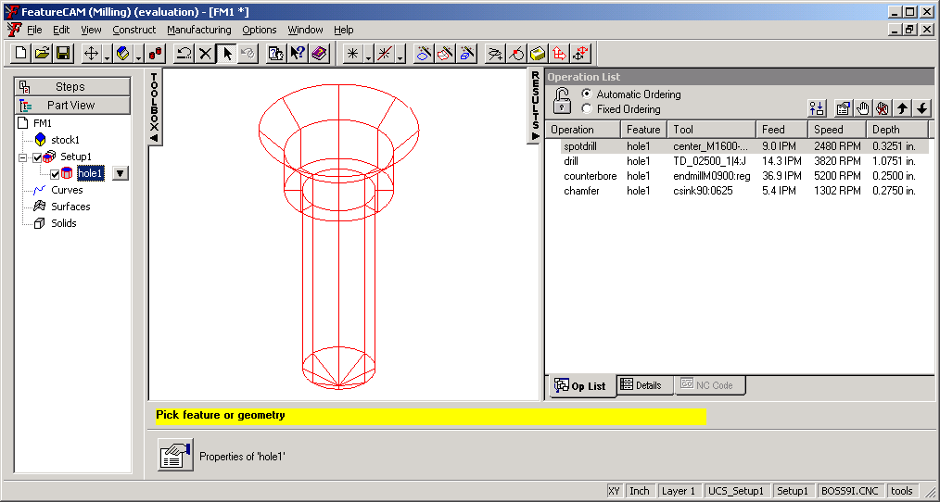
Feature UI Representations
1
2
3
The Feature name appears in the Part View
A picture of the Feature is displayed in the Graphics Window.
The Operations are listed in the Results Window.
Notes:
(At the conclusion of this slide, use the Feature wizard to create a plain hole.
Step through the wizard until the Operations page is displayed and then click Finish.
Point out how the feature is represented in each of the three portions of the interface.)

Slide 11
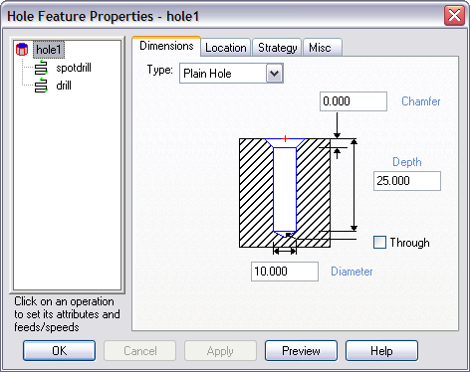
Feature Properties Dialog Box
Display by either
  Double clicking on the feature
  Selecting the feature and clicking the properties button
Selection in tree view determines the tabs that are selected
If the top level feature is selected, the tabs are similar to the pages of the Feature wizard
Tabs from wizard
Tree View
Notes:
Display by either
Double clicking on the feature
Selecting the feature in the part view or in the graphics window and clicking the properties button
Selection in tree view determines the tabs that are selected
If the top level feature is selected, the tabs are similar to the pages of the Feature wizard.
The attributes in these tabs apply to the whole feature (the affect multiple operations)

Slide 12
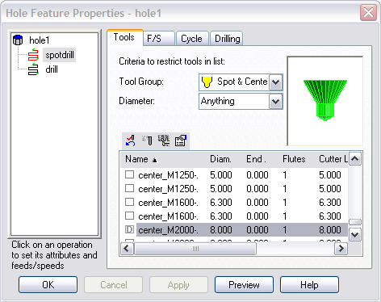
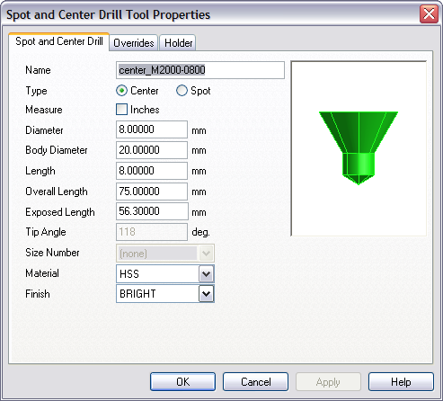
Operation Tabs
Common tabs to all features
Tools
  Used to view/change selected tooling
  Double clicking on a row displays tooling details
F/S
  Change feed or speed values

Slide 13
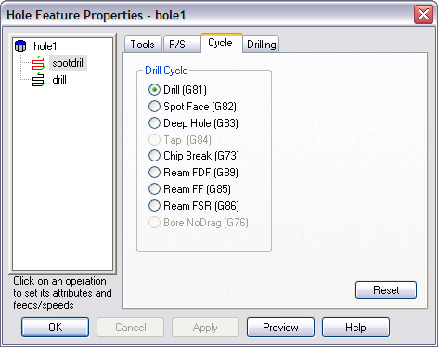
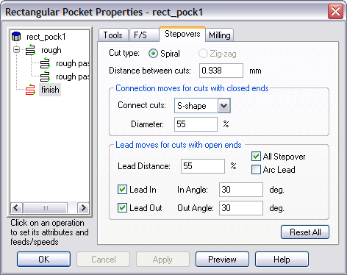
Operation Tabs
Specific tabs per feature
Drilled features
  Cycle
    Canned cycles for the operation
  Drilling
    Minor drilling parameters
Milled features
  Stepovers
    Connections, leads and stepover distances
  Milling
    Many parameters for controlling milling behavior
Notes:
Create a simple hole and rectangular pocket and demonstrate the various tabs that are available at the operations level.
***Do not go into detail on the parameters yet***

Slide 14
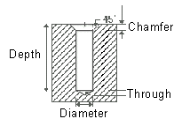
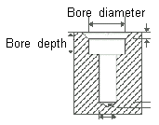
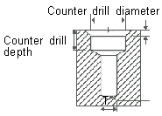
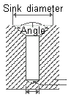
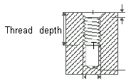
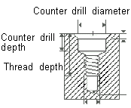
Hole Feature Types
Plain
- Optional chamfer
Counter bore
- Top hole bored
- Bottom drilled
Counter drill
- 2 drill diameters
Counter sink
- Top countersunk
- Angle can vary
Tapped
- Dimensions manual
or from a list
Counter drilled tapped
- Combines both
Notes:
By selecting a hole and showing different hole types

Slide 15
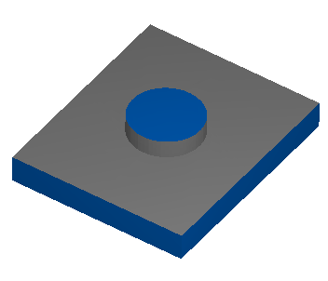
Boss Feature
Cuts from the outside-in
Requires a closed curve
If two bosses are at the same height, both curves must be included in the same feature

Slide 16
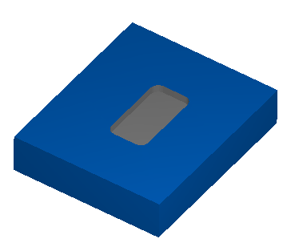
Pocket Feature
Cuts from the inside/out
Can have multiple islands
Requires a closed curve

Slide 17
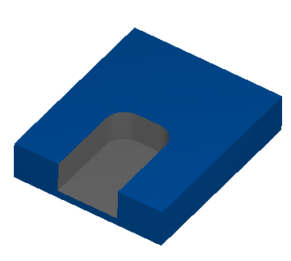
Side Feature
Most general milling feature
Will accept open or closed curves
Used to define open pockets

Slide 18
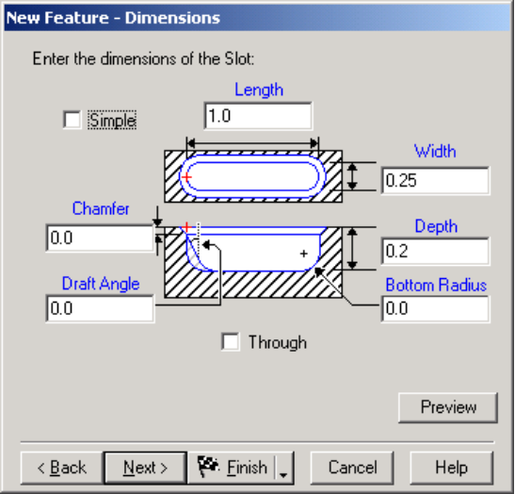
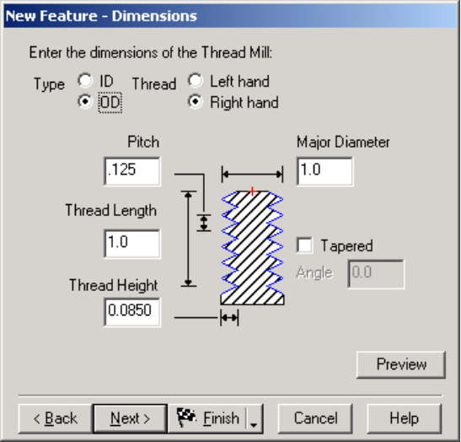
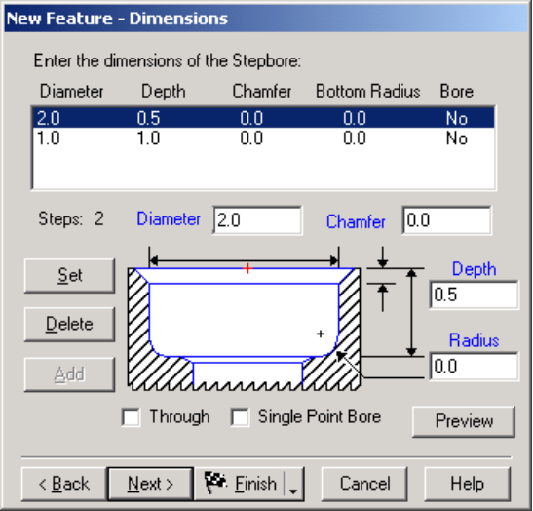
Milled Features
Slot
- Straight cut
- Simple follow center
- Non-simple roughs
and finishes
Thread Mill
- OD/ID milled threads
- Standard dimensions
included
- Supports tapers
- Single and multi-point
tools supported
Step bore
- Series of nested circular
pockets
- Optional boring operation
Notes:
Slot is a straight slot with rounded ends. No curve is needed for a slot.
Thread mill mills a thread on an inner or outer diameter. The toolpaths are accurate for UN or ISO metric threads. Adjustments must be made to the thread height or diameter to adjust for the different thread forms.
Step bore is a nested series of round pockets with a common center. No curve is needed for a step bore. A Step Bore feature is a series of nested circular pockets. You can specify a Step bore step by step, or use a number of concentric circles as the part’s curve where each circle defines a level’s diameter.

Slide 19
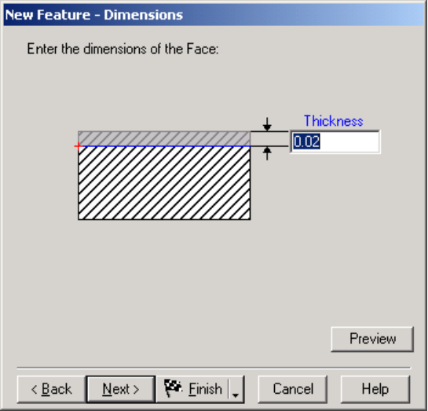
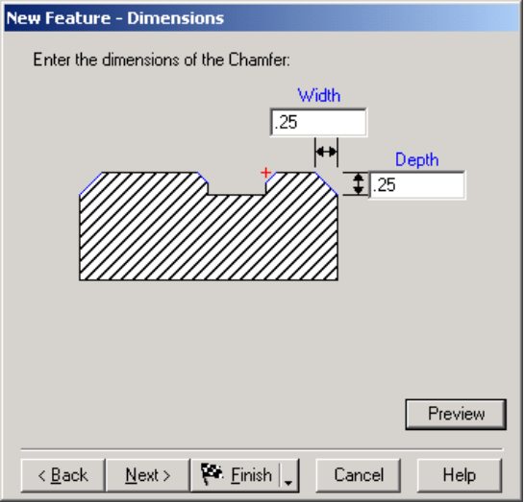
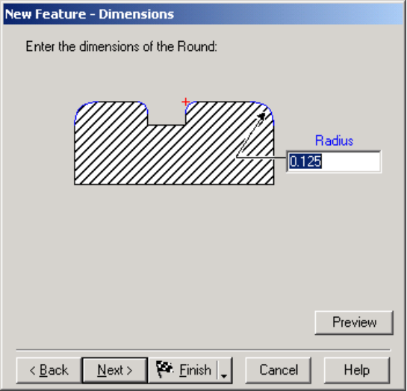
Milled Features
Face
- Cuts top of the part
- Supports rough and
finish
- Face mills or endmills
Chamfer
- Straight edgebreak
- Follows curve
- Curve can be open
Round
- Rounded edgebreak
- Follows curve
- Curve can be open
Notes:
Face is a milling operation to cut a smooth finish on a face of the stock and to cut the stock to exact dimension.
Chamfer mills a chamfer that follows a curve. Most features include a chamfer option which you should use for chamfering entire features
Round mills a rounding operation that follows a curve. The Round feature creates an edge break along a curve with a rounding tool.

Slide 20
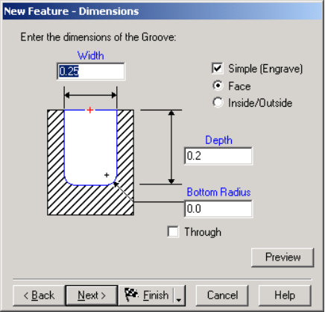
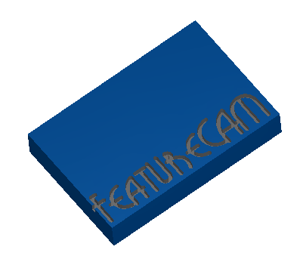
Groove Feature
2D or 3D curve
Simple
  Center of tool is aligned with the center of the curve
  Single cut
  Often used for engraving
Face
  Rough and finish
Inside/Outside
  O-ring grooves
Notes:
Groove is a groove that follows a curve. The curve is the centerline of the desired groove. Also used for engraving. Grooves support open or closed curves.
The Groove feature creates a groove of any shape. There are, however, different kinds of grooves that have different limitations For one-pass engraving click Simple so only a single manufacturing pass is performed along the curve.
Simple designates that the groove should be cut with a single pass along the curve with a tool with a diameter equal to the Width of the groove. For engraving you most likely want to create a Simple groove

Slide 21
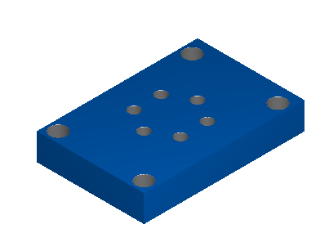
Patterns
An easy way to position a collection of features
All features must be the same in a pattern
You cannot delete an item from a pattern

Slide 22
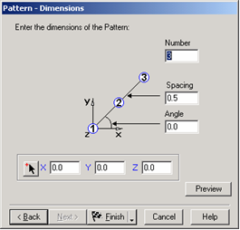
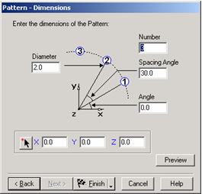
Patterns
Linear
- Straight line of features
- Specify number, spacing
and angle
Radial
- Circular pattern
- Common for bolt hole
circles
Notes:
Linear pattern
A Linear Pattern arranges the specified number of objects in a line, at the specified distance apart, starting at the specified XYZ location.
Use the treeview pane to control whether you are looking at the pattern, the object, or the manufacturing operations for the pattern. Simply highlight your choice with the mouse. The rest of the dialog box changes to reflect your choice.
Radial pattern
A Radial Pattern arranges the specified features spaced along the circumference of a circle. The spacing can be set so you only arrange features along an arc instead of the whole circle. Spacing and angles are set with dimensions settings.
Use the treeview pane to control whether you are looking at the pattern, the object, or the manufacturing operations for the pattern. Simply highlight your choice with the mouse. The rest of the dialog box changes to reflect your choice.

Slide 23
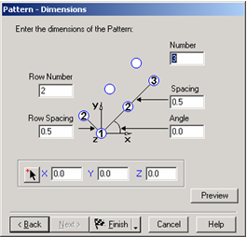
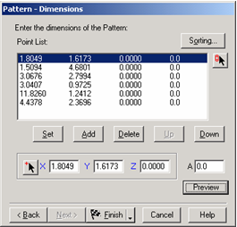
Patterns
Rectangular
- Grid of features
Point List
- Position features a list of points
- Points can come from
- Curve, points, circle centers
- Sorting options
- Shortest path, Ascending/descending
X or Y
Notes:
Rectangular pattern
A Rectangular Pattern arranges the specified number of like objects in two linear rows, with each row separating the objects at the specified spacing, and with the rows spaced as specified in row spacing, starting at the specified XYZ location.
Use the tree view pane to control whether you are looking at the pattern, the object, or the manufacturing operations for the pattern. Simply highlight your choice with the mouse. The rest of the dialog box changes to reflect your choice.
Points pattern
A Points Pattern lets you specify the location of each object explicitly. Use the tree view to move between the pattern properties, the object properties, and the manufacturing operation properties. Simply select the item in the tree view whose properties you want to see. There is a shortcut for some points patterns of holes. The different fields and buttons are described below.

Slide 24
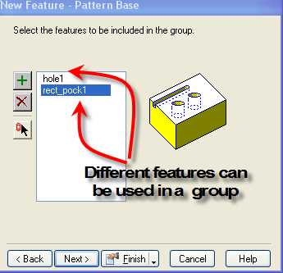
Groups
Limited Attribute control for group
User-defined feature
Attribute control still retained
Notes:
Groups of features
To enable you to efficiently model parts with repeated geometry elements in their design, FeatureMILL lets you specify groups of different features, in addition to feature patterns. When you group unlike features, you are essentially creating your own (user-defined) feature, that can then, in turn, be used as the basis feature for a pattern.
Groups are collections of features. Members of groups do not have to be the same object. Groups are often used to collect a set of objects for a pattern.
Specify patterns of a single object through the Feature Pattern Properties dialog box, accessed through the Construct menu’s Pattern and Group option. The Milling, Drilling, and Misc. tabs are the same as for the individual features in the group. Use the tree view to move between the pattern properties, the object properties, and the manufacturing operation properties. Simply select the item in the tree view whose properties you want to see.
The features contained in the group are shown in the objects list. Click on name in the list to highlight the object in the graphics window.

Slide 25
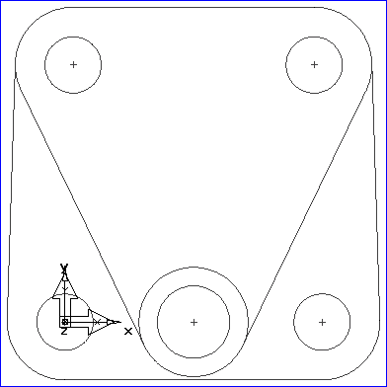
Features Example cover1.fm
Select Curves/closed and chain the outside shape by single clicking at a point along the outside shape. Type the name outside in the dialog bar, then click the Create button in the dialog bar.
Single click on the inside triangle shape and name the curve triangle, then click the Create button.
You now have 2 curves to use for features.
Triangle
Outside
Notes:
Open cover1.fm
Select Curves/closed and chain the outside shape by single clicking at a point along the outside shape.
Type the name outside in the dialog bar, then click the Create button in the dialog bar.
Single click on the inside triangle shape and name the curve triangle, then click the Create button.
You now have 2 curves to use for features.

Slide 26
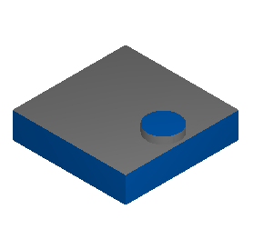
First Boss
Click the Select mode button, then select the 0.425"R circle & start the New Feature Wizard.
Select a Boss feature and click Next:
Enter: Height = 0.187, then click Finish.
Notes:
Same exercise
Click the Select mode button, then select the 0.425"R circle & start the New Feature Wizard.
Select a Boss feature and click Next:
Enter: Height = 0.187, then click Finish.

Slide 27
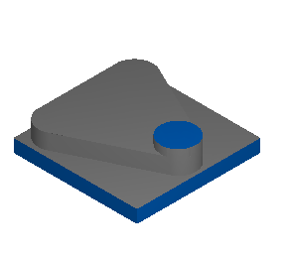
Second Boss
Click New Feature Wizard, select a Boss feature, then choose the curve triangle below, click Next:
Set Z = -0.187
Set Height = 0.375, and click Finish.
Notes:
Click New Feature Wizard, select a Boss feature, then choose the curve triangle below, click Next:
Set Z = -0.187
Set Height = 0.375, and click Finish.

Slide 28
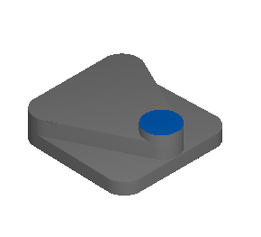
Third Boss
Click New Feature Wizard, select a Boss feature, then choose the curve outside below, click Next:
Set Z = -0.562
Set Height = 0.315, and click Finish.
Notes:
Click New Feature Wizard, select a Boss feature, then choose the curve outside below, click Next:
Set Z = -0.562
Set Height = 0.315, and click Finish.

Slide 29

Bottom Holes
Select the two lower 0.2188”R circles (use the Ctrl + Click method to select both at the same time), then click the New Feature Wizard. Notice Hole feature and Make a pattern from this feature are selected. Click Next.
Set Depth = 0.313 and click Finish
Notes:
Select the two lower 0.2188”R circles (use the Ctrl + Click method to select both at the same time), then click the New Feature Wizard. Notice Hole feature and Make a pattern from this feature are selected. Click Next.
Set Depth = 0.313 and click Finish

Slide 30

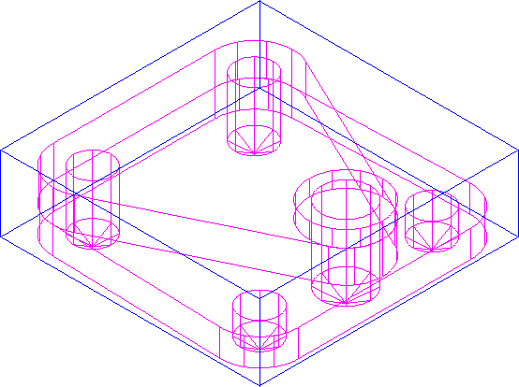
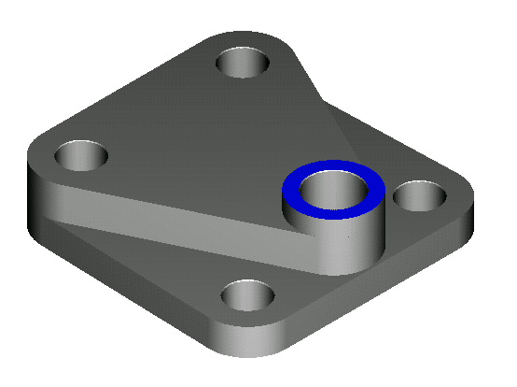
Top Holes
Select the two upper 0.2188” R circles and make a hole pattern for them.
Set Depth = 0.688, and click Finish.
Select the 0.2813”R circle, and make a hole with depth 0.875
Notes:
Select the two upper 0.2188” R circles and make a hole pattern for them.
Set Depth = 0.688, and click Finish.
Select the 0.2813”R circle, and make a hole with depth 0.875

Slide 31
Course Review
Feature creation
Drilled features
Milled features
Create our first part features

Slide 32
Questions?

